Slide 1
Implementing 802.11ah
Migration analysis from a 802.11/a/g/p transceiver in GNUradio
D. Zwart Technical University of Delft
Delivered: 16-05-2018

Slide 2
Pre-word
Documentation associated with this presentation can be found in wiki. Please refer to this github wiki for updated references to:
Reports
Papers
Matlab sources
GNUradio sources
Slides show a (->) link in the title, which links to the wiki.
TX: transmitter end (simple)
RX: receiver end (complex → equalization)

Slide 3
Contents
Previous developments
Achievements D. Verhaert
Limitations (changes to make model work)
Current work
Goals w.r.t reality
+ Achievements
+ Documentation
Points of attention
Future implementation

Slide 4
Previous developments (1/2) (->)
Goal: GNUradio transceiver with
USRP N210 SDR with 2x VERT900 antenna’s
Ubuntu 16.04 LTS
Pybombs & GNUradio (long prefix build time)
Installation guide by D. Verhaert avoids GNUradio, Apache & USRP driver trouble
Given block model, slightly adapted

Slide 5
D. Verhaert achievements (->)
GNUradio transceiver with slight adaptations:
Based on 2.4GHz 802.11a/g/p
Added USA frequency option (902 – 928 MHz)
Set channel BW to 2 MHz
Added file sink as capture (FileSinkah)
Attempted higher MCS indices, removed because of packet loss.
Successfully transmitted small WiFi payloads (no ETH layer, pure PHY+MAC)
Reproducible results

Slide 6
Previous developments (2/2) (->)
Removed an experimental Correct IQ block (Commit)
Fix GNUradio root access to OOT blocks (Out-Of-Tree) (sudo shell script, TODO link)
Block model was now runnable.
More configuration needed…

Slide 7
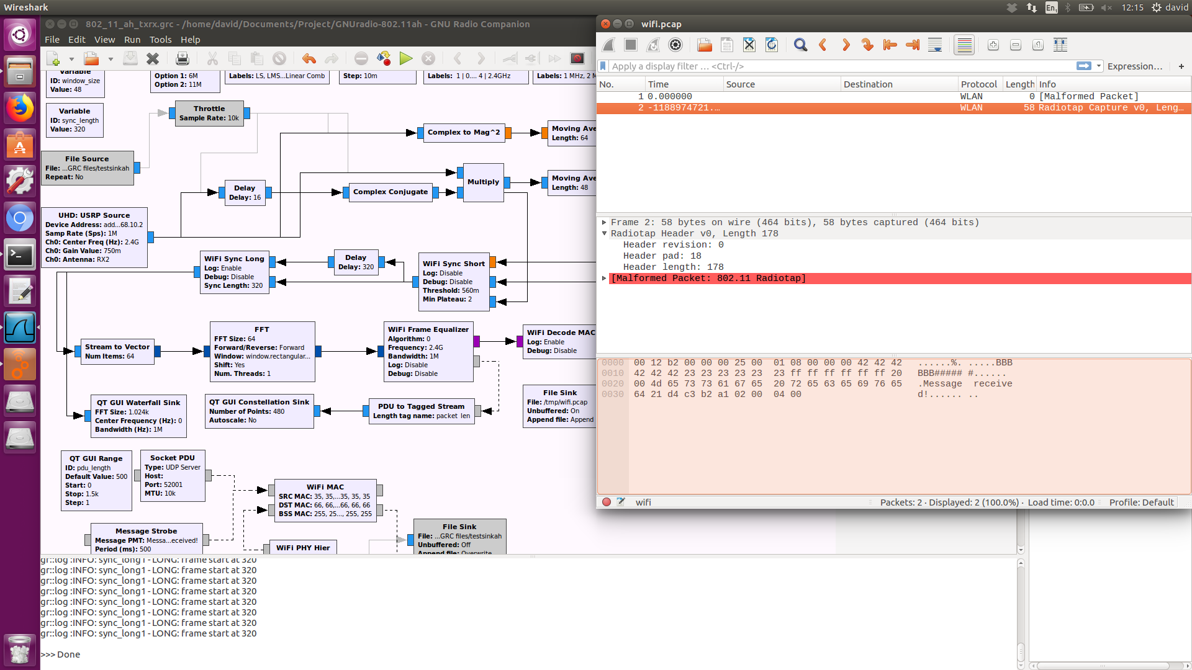
Limitations (1/3)
Very chaotic block scheme, flow connections all over the place.
Malformed packets (Wireshark), or no packets received at all.
USRP buffer overflow
Very spread-out OFDM subcarrier I/Q constellation points.

Slide 8
Limitations (2/3)
Fixes to GNUradio configurations:
USRP TX “LO offset”
Set to 6 MHz in order to be able to receive packets (why?)
Sampling rate had to be at least 2 MHz
Sampling rate == Channel bandwith (I/Q)
Channel bandwith of 1 MHz didn’t work
802.11ah proposal demands robustness in STF and LTF.
Robustness changes not yet implemented.

Slide 9
Limitations (3/3)
Added European frequency band
(863 – 868 MHz)
High MCS index -> no reliable reception
QAM64 didn’t work, didn’t even try QAM256
Intermezzo:
A lot was lacking in not only the model, but also the underlaying OOT blocks.
Find literature & understand OFDM concepts first before applying anything in GNUradio or C++.

Slide 10
Current work (1/15)
Goals
Implement ‘low hanging fruit’ changes for 802.11ah PHY in model and sub-model blocks.
Study 802.11ah PHY & MAC layer interaction.
Reality
Lack of knowledge or new to:
GNUradio, OFDM, encoding
Changes have snowball effect due to ‘hardcoded’ or static state of 802.11a/g/p model
TX side barely adjustable, complexity too high
Approach
Find lots and lots of reliable / filtered resources
Document everything
Implement only top-level changes for clarity

Slide 11
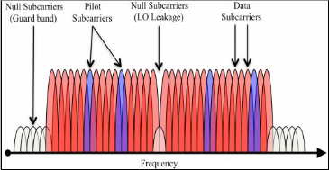
Current work – goals (2/15)
Specific goals
Learn about PHY specification
MCS changes
S1G vs no-HT / HT / VHT
Sync changes
OFDM changes
Learn about OFDM
Symbol to carriers (Pilot, data, guard carriers)
Encoding (interleave, scramble, etc.)
Cyclic prefixing
Document changes in code

Slide 12
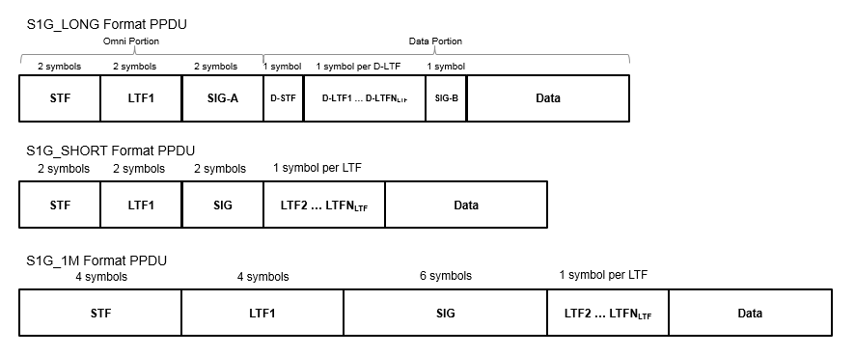
Current work – S1G (3/15)
S1G types (mathworks)
Very similar to 802.11ac!
Changes are simple on TX side, very complex on RX side.
Skip RX, do TX only. Adjust goals

Slide 13
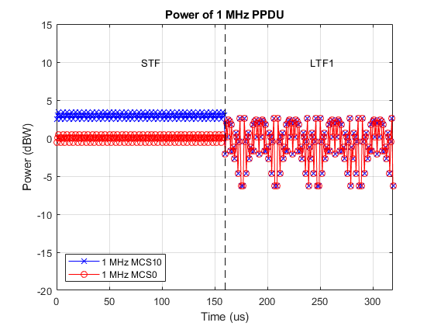
Current work – S1G (4/15)
S1G types (mathworks)
Beamforming requirements are out of scope
Repeated PHY fields introduced for following 3 types:
S1G_1M (1MHz)
Introduces MCS10, repeated BPSK 1/2, +3dB STF)
STF, LTF, SIG fields repeated
S1G_SHORT (>1MHz)
LTF₂ … LTF_{N} introduced
Most similar to legacy 802.11 PHY
S1G_LONG (>1MHz)
SIG-A field
D-STF
D-LTF1…N
SIG-B field
MCS10 vs MCS0 (src)

Slide 14
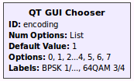
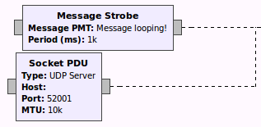
Current work – S1G (5/15)
S1G types (mathworks)
Needs to be added to top level as either:
Qt dropdown (static)
Signal generation block (adjustable, dynamic?)
TX side
PHY OFDM allocator won’t accept these inputs…
RX side
Long Sync, Short Sync & Frame Equalizer need great deal of adjustment (too complex, static, bit-banging?)

Slide 15
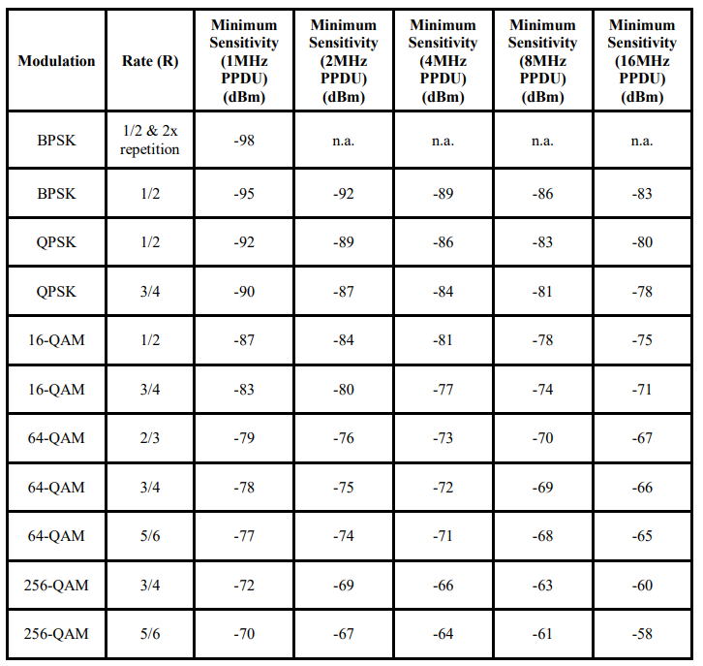
Current work – MCS (6/15) (->)
MCS changes (book-keeping)
256-QAM (all S1G types)
BPSK 2x (S1G_1M only)
TX side:
Top-level
Add to QT-GUI dropdown
WiFi PHY Hier block
WiFi Mapper block (Mapper)
OFDM params (Utils)
Puncturing (Utils)
Chunks to symbols (.cc, .h)
RX side
Sync Short :|
Sync Long Block :S
Frame Equalizer :O

Slide 16
Current work – OFDM (7/15) (->)
802.11ah OFDM carrier mapping (paper, (->))
Same as 802.11ac
Surely the carriers in GNUradio aren’t statically allocated…
BW | FFT bins | Data | Pilot | Carrier distr.
1 MHz | 32 | 24 | 2 | 26 sub, 5 guard, 1 DC
2 MHz | 64 | 52 | 4 | 56 sub, 7 guard, 1 DC
4 MHz | 124 | 108 | 6 | 114 sub, 9 guard, 1 DC
8 MHz | 256 | 234 | 8 | 250 sub, 13 guard, 1 DC
16 MHz | 512 | 468 | 18 | 484 sub, 27 guard, 1 DC

Slide 17
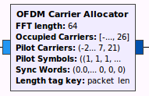
Current work (8/15) (->)
BW | FFT | D | P
1 MHz | 32 | 24 | 2
2 MHz | 64 | 52 | 4
4 MHz | 124 | 108 | 6
8 MHz | 256 | 234 | 8
16 MHz | 512 | 468 | 18
Oh god… (doxygen)
An Out-Of-Tree block needs to be built called HaLow OFDM Carrier Allocator (doxygen).
Could be accompanied with HaLow Sync Generator (for custom STF, LTF)
Parameters:
Travelling pilots (boolean)
Debug (boolean)
Length tag key (string)
Bandwidth (int)
Inputs:
Data stream (pmt)
Sync words (vector)
Output:
OFDM symbols
Semantics
It should throw warnings when data carriers are left unused.
It should throw exceptions when pilot carriers overlap data carrier indices
Build function mapping bandwidth to predefined pilot carriers, etc.

Slide 18
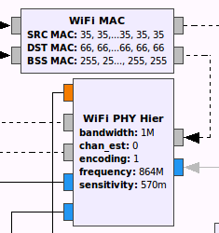
Current work – Block model(9/15)
Is the block model working correctly?
Yes: for 20 MHz (WiFi)
No: for 1,2 MHz (HaLow Europe)
Is the model clear?
Yes: PHY and MAC clearly presented
No:
Clutter around it
PHY layer copied into top-layer?

Slide 19
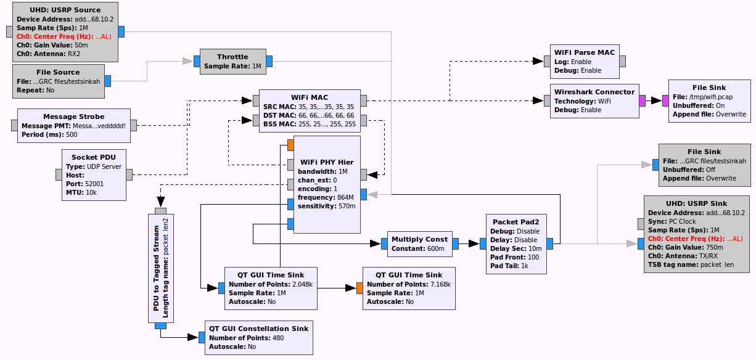
Current work – New model (10/15)

Slide 20
Current work – New model (11/15)
Organized into 3 lab setups:
Direct loopback (new, no channel!)
If loopback is broken: the code is broken
USRP
If this doesn’t work:
LO offset = 6 MHz?
Probably didn’t follow specs correctly
Wrong antenna? VERT900 vs VERT2400
Software suitable? (reference)
File sink / source
Never used → Wireshark sink is handier
Can be used for automated unit testing on higher abstraction level?

Slide 21
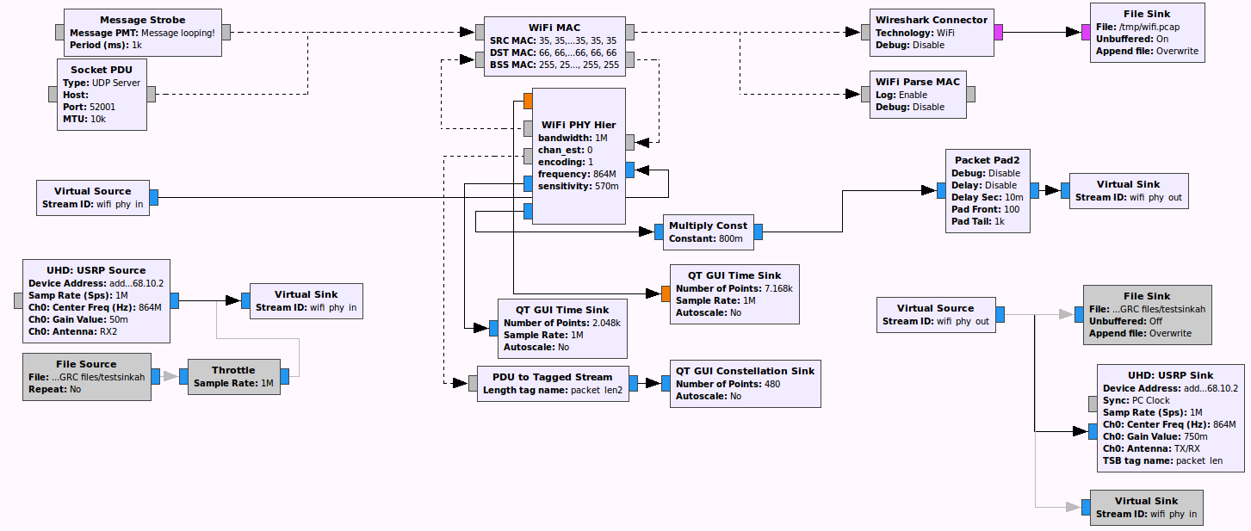
Current work – New model (12/15)
Virtualized so no new routes are needed (just disable/enable blocks)

Slide 22
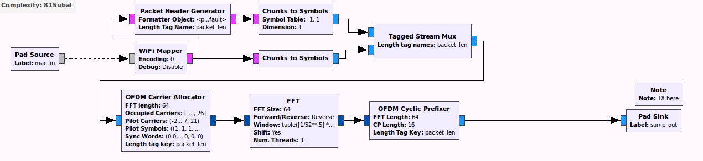
Current work – PHY Hier (13/15)
Transmitter just organized and studied, nothing changed.

Slide 23
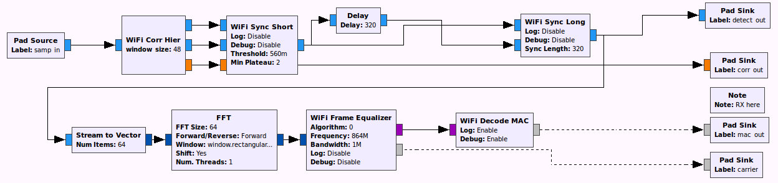
Current work – PHY Hier (14/15)
Receiver; put correlator blocks into Correlator Hier (`wifi_corr_hier.grc`)
Added more debugging output
Organized input vs output better

Slide 24
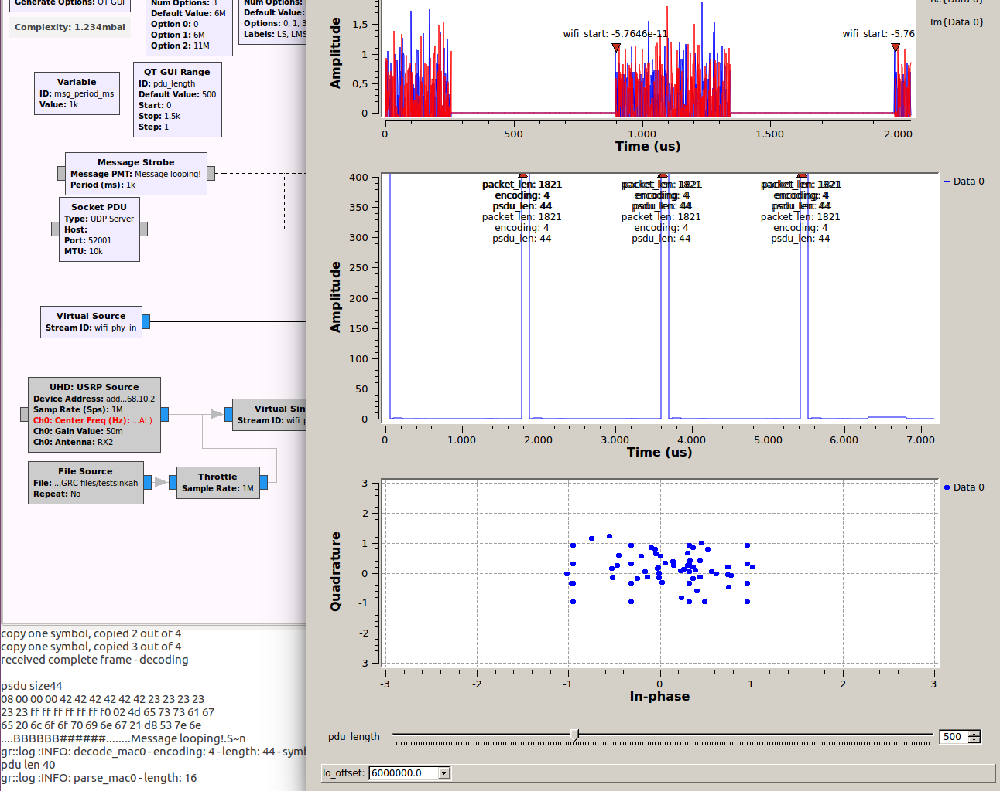
Current work – GUI (15/15)
Direct loopback shows clearer results
about bad or good detection.
(For example, when the correlator is
not connected properly, the constellation shows no points,
but the signals do arrive.)
Debugging output

Slide 25
Points of notice
Although this presentation lacks information about MAC layer:
AID, RAW, TIM, TXOP, SST, Virtual Carrier Sense, Beamforming (MIMO)
They were studied
Infeasible without a structured PHY layer
Hard to test with 1 USRP

Slide 26
Future implementation
Skip RX for now, focus on TX.
Start with OFDM block replacement
Conform S1G specification
Add MCS-8,9,10
Add TX output debugging
Change MAC fields
(moving QoS, HT to PHY... removing Duration)
Change PHY fields
(moving QoS, HT to PHY... NDP type MAC content to PHY for VCS in NAV)

Slide 27
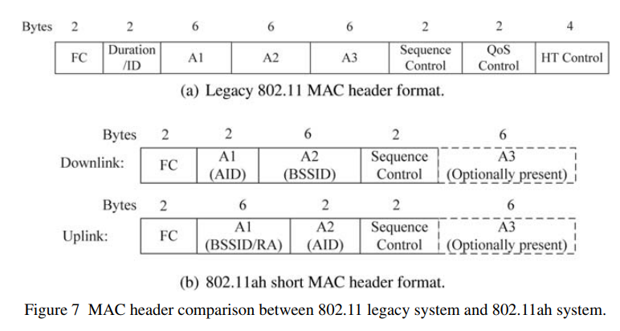
MAC layer (->)
Small changes
Conditional field sizes (type)!
Null Data type packet (NDP, out of scope)

Slide 28
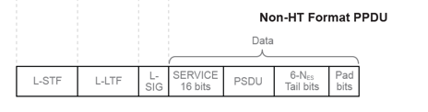
PHY layer (url)
Major changes
NDP SIG-field adjustment?
Packet type depency?
vs

Slide 29
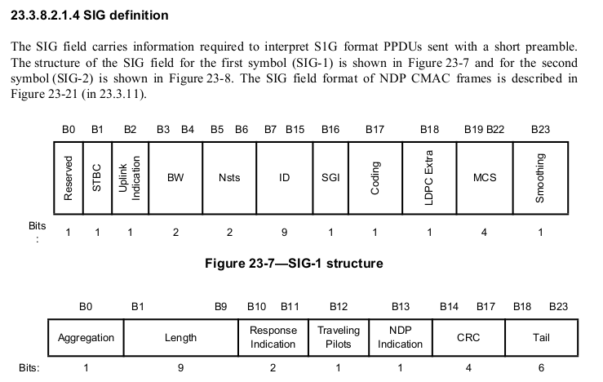
PHY - SIG field
Major changes (IEEE specs)
Adjusted to fancy features by 802.11ah/ac

Slide 30
For more info
https://github.com/... Fully documented Wiki

